Slide 1
Fuzzy Sentiment Analysis Using Convolutional Neural Network
Sugiyarto, Joko Eliyanto, Nursyiva Irsalinda, Meita Fitrianawati

Slide 2
Outline
Problem Background
Dataset
Sentiment Analysis using Convolutional Neural Networks
Fuzzy Sentiment Analysis using CNN
Conclusion

Slide 3
Problem Background
Sentiment analysis is way to understand the sentiments contained in a sentence. The sentence sentiment can be negative, neutral or positive.
Big Data on text mining experience today. We need sentiment analysis method that deal with dynamism on meet new language or new vocabulary.
In fact, each sentence does not always have positive, negative or neutral sentiment clearly. We need a technique to describe the ambiguity of sentence sentiment or sentiment degree.

Slide 4
Sentiment Analysis using CNN(Machine Learning)
Why Machine Learning Model?
Machine learning approach have a dynamism to meet with new language datasets or new vocabulary.
Better than a lexicon-based approach.
This data trained using machine learning is very influential on the resulting classification model, the greater dataset will give the better result.

Slide 5
Sentiment Analysis using CNN(Machine Learning)
Why CNN?
CNN is One of Popular Algorithm of Classification Problem in Machine Learning
CNN has the best level of accuracy based on some research in previous.
It has advantages for feature extraction

Slide 6
Fuzzy Sentiment Analysis
Why Fuzzy Logic?
Fuzzy logic allows for the inclusion of vague human assessments in computing problems.
New computing methods based on fuzzy logic can be used in the development of intelligent systems for decision making, identification, pattern recognition, optimization, and control.

Slide 7
Research Objective
Calculate sentiment analysis classification using CNN
Build sentiment score in fuzzy form based on CNN result
Calculate the Euclid distance between two type of sentiment score with sentiment label.

Slide 8
Dataset
TABLE 1. Sentiment Analysis Dataset.
Dataset | Sentiment Class | Records | CSV File Size
Indonesian Sentiment Twitter | 3 | 10.806 | KB
Airline Sentiment Twitter | 3 | 14.640 | 3.073 KB
IMDB Film Review | 2 | 50.000 | 64.661 KB

Slide 9
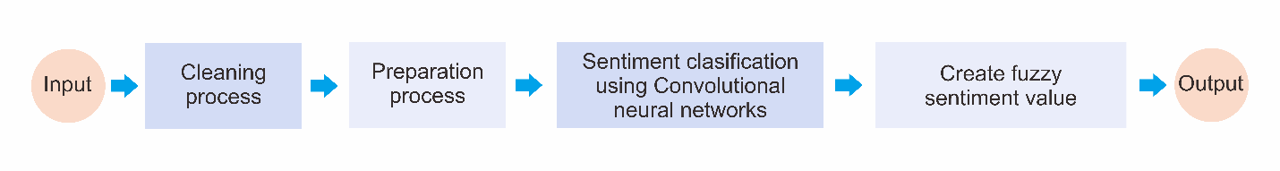
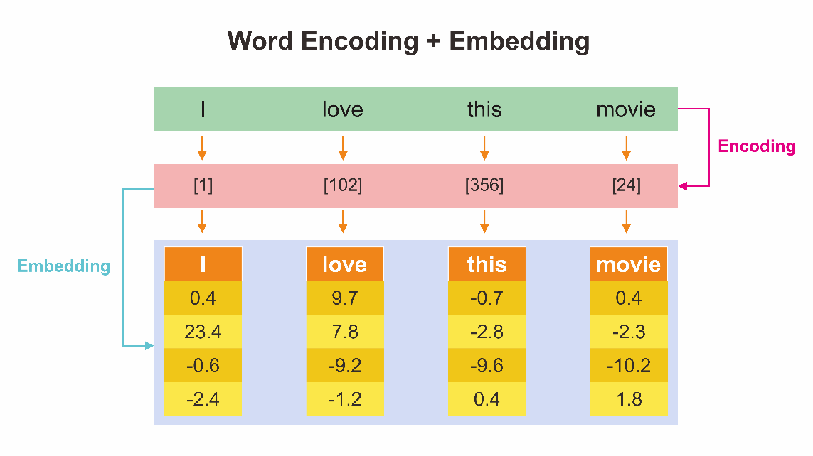
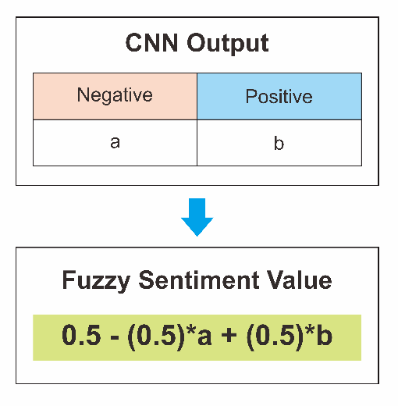
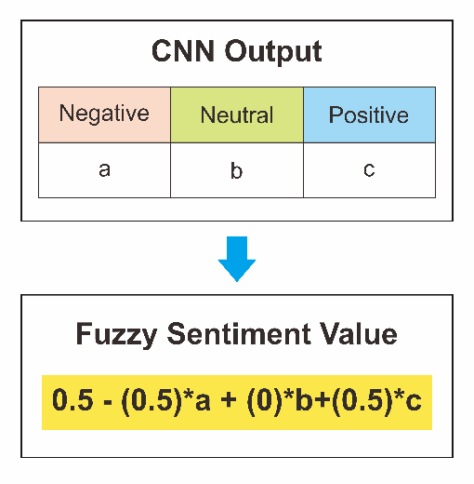
Fuzzy Sentiment Analysis using CNN

Slide 10
CNN Model Result
TABLE 2. Convolutional neural networks model accuracy.
Dataset | Training Accuracy | Validation Accuracy | Epoch Number
Indonesian Sentiment Twitter | 98.44 % | 53.44 % | 100
Airline Sentiment Twitter | 99.56 % | 76.40 % | 100
IMDB Film Review | 99.99 % | 86.88 % | 40

Slide 11
CNN Model Result
TABLE 3. Fuzzy sentiment analysis
Indonesian Sentimen Twitter Dataset
Text | Sentiment Label | Sentiment Prediction using CNN | Fuzzy Sentiment Prediction using CNN
lagu bosan apa yang aku save ni huhuhuhuhuhuhuhuhuhuuuuuuuuuuuuuu | Negatif [0] | [0] | 0.0000
kita lanjutkan saja diam ini hingga kau dan aku mengerti tidak semua kebersamaan harus melibatkan hati | Negatif [0] | [0.5] | 0.4986
makasih loh ntar kita bagi hasil aku 99 9 sisanya buat kamu | Positif [1] | [1] | 0.9994
aku tak faham betul jenis orang malaysia yang tak reti nak sangkut balik hose tu aku geli bodoh nak pegang | Positif [1] | [1] | 0.9999
Airline Sentiment Twitter
what dhepburn said. | Neutral [0.5] | [0.5] | 0.4999
plus you've added commercials to the experience tacky. | Positif [1] | [1] | 0.9999
i didn't today... Must mean I need to take another trip! | Neutral [0.5] | [0.5] | 0.4999
it's really aggressive to blast obnoxious "entertainment" in your guests' faces &amp; they have little recourse | Negatif [0] | [0] | 0.0000
IMDB Film Review
One of the other reviewers has mentioned that ... | Positif [1] | [1] | 1.0000
A wonderful little production. The filming tec... | Positif [1] | [1] | 1.0000
I thought this was a wonderful way to spend ti.. | Positif [1] | [1] | 0.9999
Basically there's a family where a little boy ... | Negatif [0] | [0] | 0.0035

Slide 12
Measuring Fuzzy Sentiment VS Hard Sentiment Performance

Slide 13
Conclusion
The fuzzy convolutional neural networks can give a sentiment value in fuzzy form.
Sentiment in fuzzy form bears a better resemblance to the original class label compared to convolutional neural networks sentiment values.
The application of the fuzzy concept in the classification process until the output results are still in the form of a fuzzy set is recommended for further research.

Slide 14

Thank You

